Slide 1
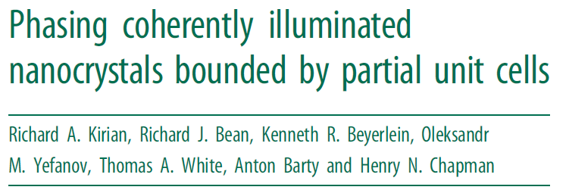
BioXFEL Journal Club
Journal Club Presenter:
George Calvey
Pollack Group
Cornell University

Slide 2
Introduction
Considers the effect of incomplete unit cells at boundary of nanocrystals
Implications for Serial Femtosecond Crystallography
Analytically evaluates 1D case
Numerically evaluates 2D case
Results useful for future phasing algorithms that utilize information away from Bragg peaks.

Slide 3
Intro/Framework
Considers unit cell with an asymmetric part and a corresponding symmetry pair
Unit Cell

Slide 4
Intro/Framework
Considers unit cell with an asymmetric unit and a corresponding symmetry pair
Symmetry pair
A
B
$$B(r)=A(Rr−t)$$
Unit Cell

Slide 5
Intro/Framework
Define sub-lattice for asymmetric unit and symmetry pair
$o_{nj}^{α} and o_{nj}^{β}$ are occupancy of lattice point j
Lattice points

Slide 6
Intro/Framework
Define sub-lattice for asymmetric unit and symmetry pair
$o_{nj}^{α} and o_{nj}^{β}$ are occupancy of lattice point j
$$o_{n1}^{α}=1$$
$$o_{n1}^{β}=1$$

Slide 7
Intro/Framework
Define sub-lattice for asymmetric unit and symmetry pair
$$o_{nm}^{α}=1$$
$$o_{nm}^{β}=0$$
$o_{nj}^{α} and o_{nj}^{β}$ are occupancy of lattice point j
$$o_{n1}^{α}=1$$
$$o_{n1}^{β}=1$$

Slide 8
Intro/Framework
Define electron density in this framework:

Slide 9
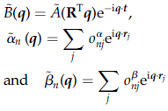
Intro/Framework
Define electron density in this framework:
$$ℱ\left\{ρ\left(r\right)=A\left(r\right)⨂α\left(r\right)+B\left(r\right)⨂β\left(r\right)\right\}→$$
$$ρ\left(q\right)=A\left(q\right)α\left(q\right)+B\left(q\right)β(q)$$

Slide 10
Intro/Framework
Scattering intensity $I_{n}(q)$ in terms of previous functions

Slide 11
1D Crystal
1D crystal with two molecule unit cell

Slide 12
1D Crystal
1D crystal with two molecule unit cell
Average intensity proportional to average of type (i) and (ii) less the scattering from the missing molecules in (iii) and (iv)

Slide 13
2D Crystal
Part of Crystal
Asymmetric Unit
Symmetry Pair

Slide 14
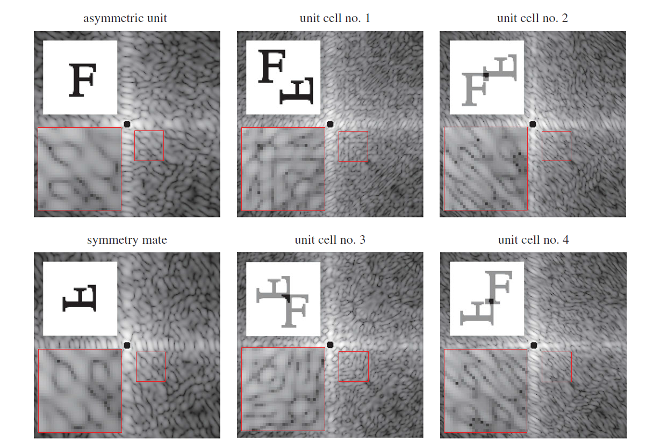
2D Crystal, 4 Possible Unit Cells

Slide 15
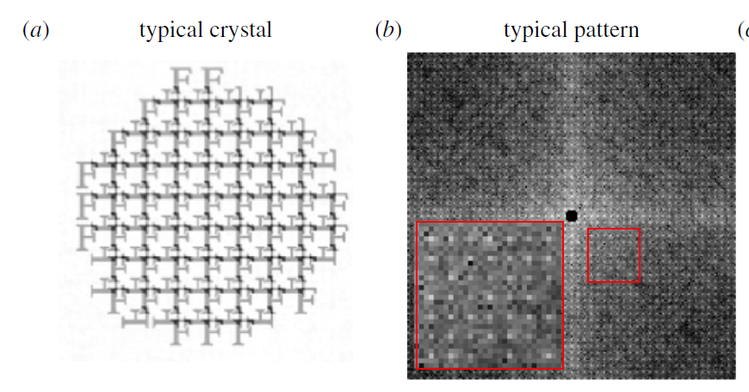
2D Crystal Simulation
500 diffraction snapshots of crystals with random edge termination

Slide 16
2D Crystal Simulation
Compare average intensities,${\left\langle I_{n}\left(q\right)\right\rangle }_{n}$, from 500 patterns to superposition of 4 unit cell patterns
$$I_{ideal}(q)=\sum_{i=1}^{4}{I^{i}}(q)$$
First need to remove lattice contribution from data
$$I\left(q\right)=I^{0} (q)/I_{WZ}\left(q\right)$$
Average
Lattice Transform

Slide 17
2D Crystal Simulation
Compute normalized difference (w/ scale factor $η$)
Result: R=0.07
Well approximated by incoherent superposition

Slide 18
Phasing 2D Crystal Simulation
Applied a method for reconstruction from symmetry averaged diffraction patterns
Assumed intensity is equal to superposition of the computed unit cells’ diffraction
Compared with diffraction intensity data
Result: R=0.07 $→$ potentially limited by above assumption

Slide 19
Conclusion
Useful study for future phasing algorithms that use information away from Bragg peaks
As suggested in the paper, an algorithm that does not rely solely on equal superposition may be more robust

