Slide 1
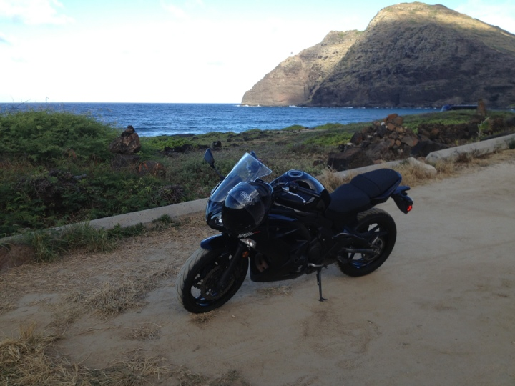

Crystallography with an FEL
Marc Messerschmidt
BioXFEL Science and Technology Center
Buffalo, June 2014

Slide 2
Outline
The LCLS
  Machine capabilities
  Spectrum
LCLS instruments for crystallography
CSPad detector
sample injectors for serial femtosecond crystallography
First results
Future Developments

Slide 3
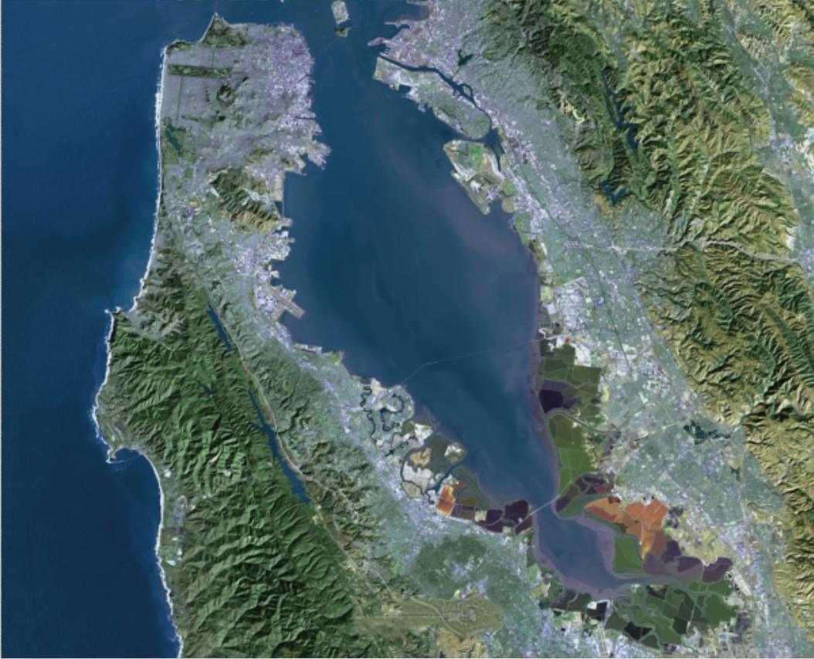
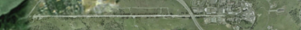
Linac Coherent Light Source
San Francisco
SLAC

Slide 4
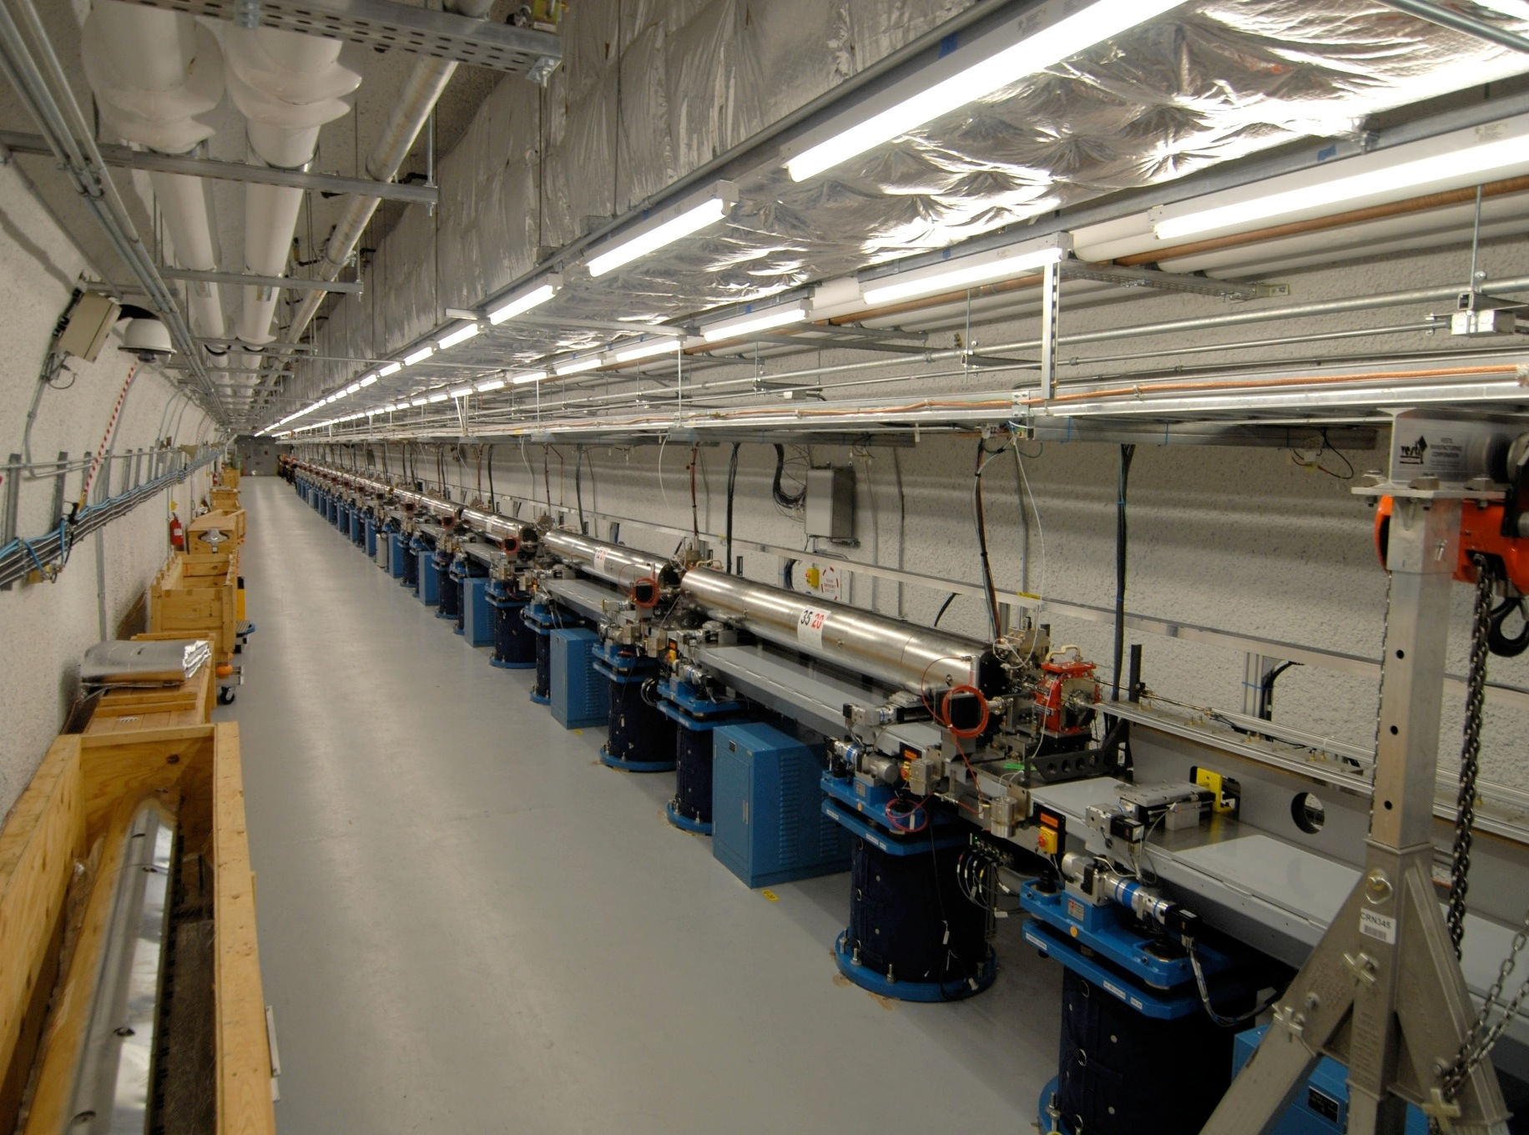
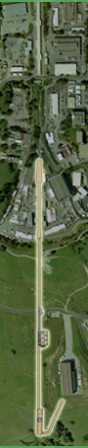
LCLS Performance
32 undulators
  Total length: 132 m
Spectral coverage: 0.3-10.5 keV
  3rd harmonic to 25 keV
    up to 1% of fundamental intensity
up to 10¹³ photons per pulse
0.01 - 3% bandwidth (0.3% jitter)
Pulse duration: 3-500 fs
Repetition rate: 120 Hz
P. Emma, et al., Nature Photonics, 4(2010), 641-647

Slide 5
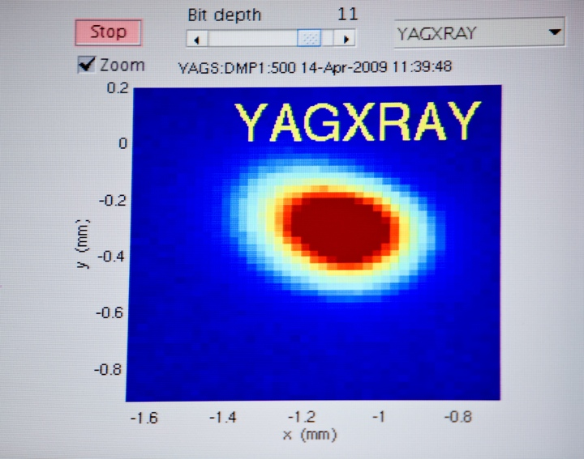
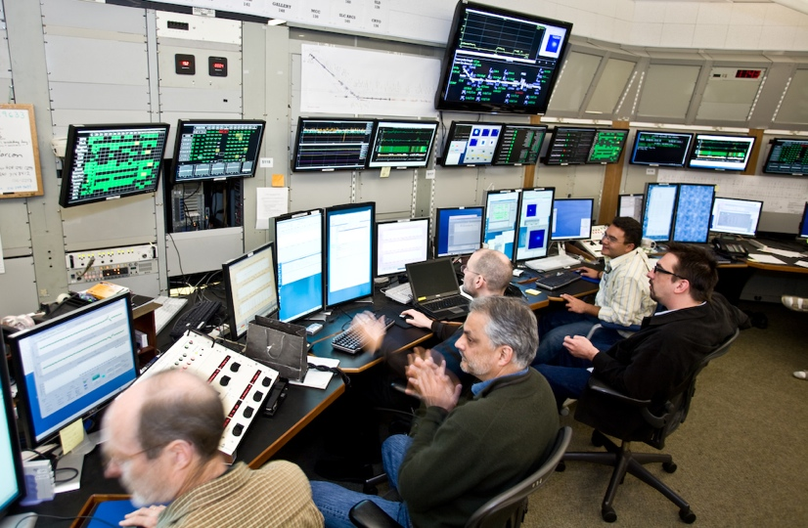
LCLS initial performance
First lasing and operation of an angstrom-wavelength free-electron laser
Author(s): Emma, P (Emma, P.)[ 1 ] ; Akre, R (Akre, R.)[ 1 ] ; Arthur, J (Arthur, J.)[ 1 ] ; Bionta, R (Bionta, R.)[ 2 ] ; Bostedt, C (Bostedt, C.)[ 1 ] ; Bozek, J (Bozek, J.)[ 1 ] ; Brachmann, A (Brachmann, A.)[ 1 ] ; Bucksbaum, P (Bucksbaum, P.)[ 1 ] ; Coffee, R (Coffee, R.)[ 1 ] ; Decker, FJ (Decker, F. -J.)[ 1 ] ; Ding, Y (Ding, Y.)[ 1 ] ; Dowell, D (Dowell, D.)[ 1 ] ; Edstrom, S (Edstrom, S.)[ 1 ] ; Fisher, A (Fisher, A.)[ 1 ] ; Frisch, J (Frisch, J.)[ 1 ] ; Gilevich, S (Gilevich, S.)[ 1 ] ; Hastings, J (Hastings, J.)[ 1 ] ; Hays, G (Hays, G.)[ 1 ] ; Hering, P (Hering, Ph.)[ 1 ] ; Huang, Z (Huang, Z.)[ 1 ] ; Iverson, R (Iverson, R.)[ 1 ] ; Loos, H (Loos, H.)[ 1 ] ; Messerschmidt, M (Messerschmidt, M.)[ 1 ] ; Miahnahri, A (Miahnahri, A.)[ 1 ] ; Moeller, S (Moeller, S.)[ 1 ] ; Nuhn, HD (Nuhn, H. -D.)[ 1 ] ; Pile, G (Pile, G.)[ 3 ] ; Ratner, D (Ratner, D.)[ 1 ] ; Rzepiela, J (Rzepiela, J.)[ 1 ] ; Schultz, D (Schultz, D.)[ 1 ] ; Smith, T (Smith, T.)[ 1 ] ; Stefan, P (Stefan, P.)[ 1 ] ; Tompkins, H (Tompkins, H.)[ 1 ] ; Turner, J (Turner, J.)[ 1 ] ; Welch, J (Welch, J.)[ 1 ] ; White, W (White, W.)[ 1 ] ; Wu, J (Wu, J.)[ 1 ] ; Yocky, G (Yocky, G.)[ 1 ] ; Galayda, J (Galayda, J.)[ 1 ]
Source: NATURE PHOTONICS Volume: 4 Issue: 9 Pages: 641-647 DOI: 10.1038/NPHOTON.2010.176 Published: SEP 2010
Times Cited: 563

Slide 6
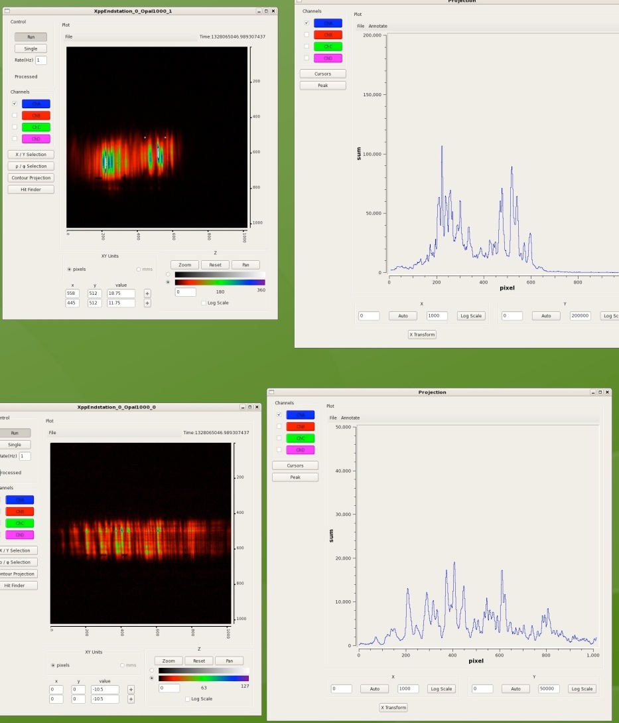
Hard X-ray spectrum at LCLS

Slide 7
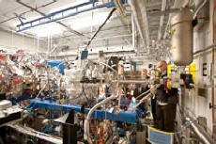
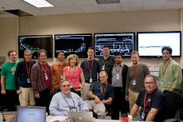
AMO instrument
Atomic, Molecular and Optical Science
with ultrafast and ultraintense X-rays at the LCLS
Techniques
Electron time-of-flight spectroscopy
Ion time-of-flight spectroscopy
Ion imaging
Ion momentum spectroscopy
X-ray scattering

Slide 8
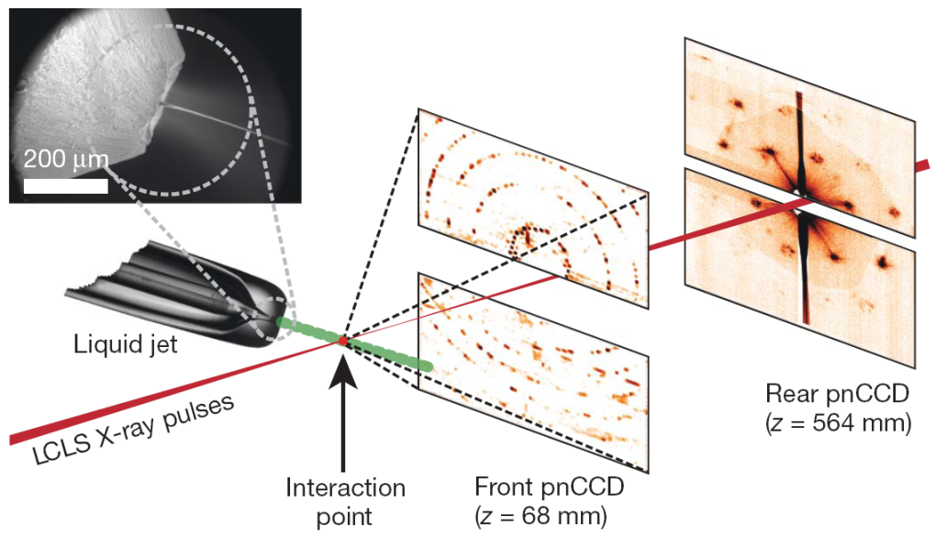
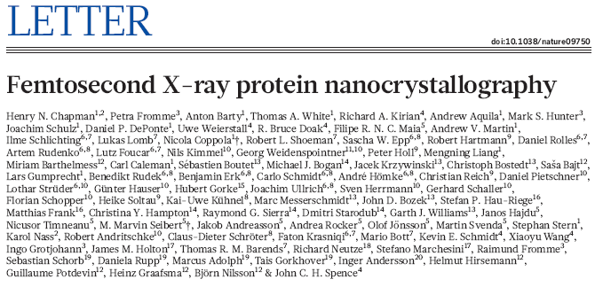
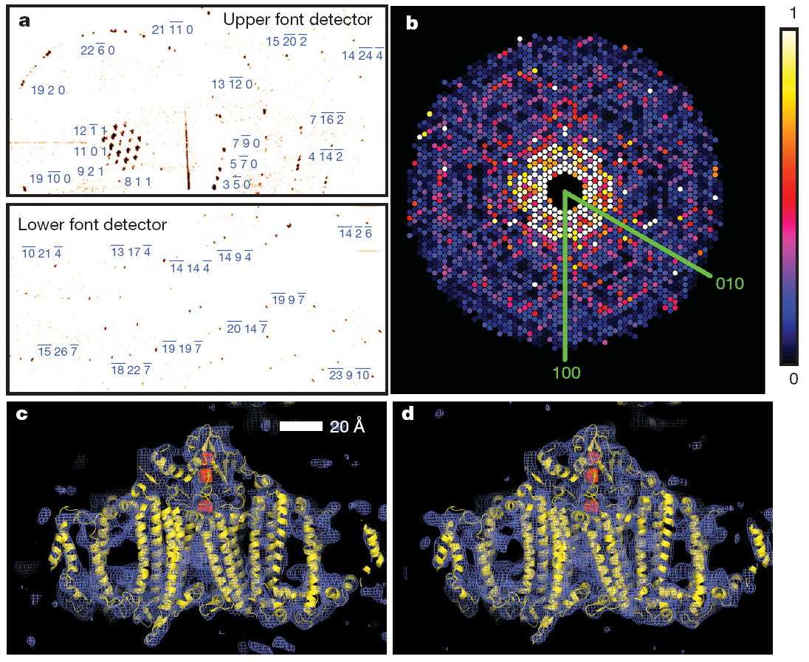
Femtosecond Protein Nanocrystallography Using Soft X-rays
Low resolution structure of Photosystem I determined from ~15,000 nanocrystals
Each crystal was illuminated sequentially and destroyed by the LCLS beam
Dose ~30 times larger than classical damage limit
  >700 MGy
Unfortunately, low photon energy at AMO limited resolution and chance for new biology
Synchroton
LCLS
Chapman et al. Nature Physics 470, 73-77 (2011)

Slide 9
XPP instrument
Scientific Applications
Femtosecond Structural Dynamics
X-ray Interactions with Matter
X-ray Techniques
Wide Angle X-ray Scattering/Diffraction
Small Angle X-rays Scattering
X-ray Absorption Spectroscopy
X-ray Emission Spectroscopy

Slide 10
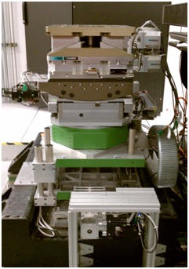
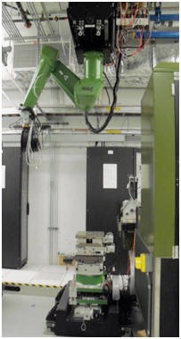
XPP instrument

Slide 11
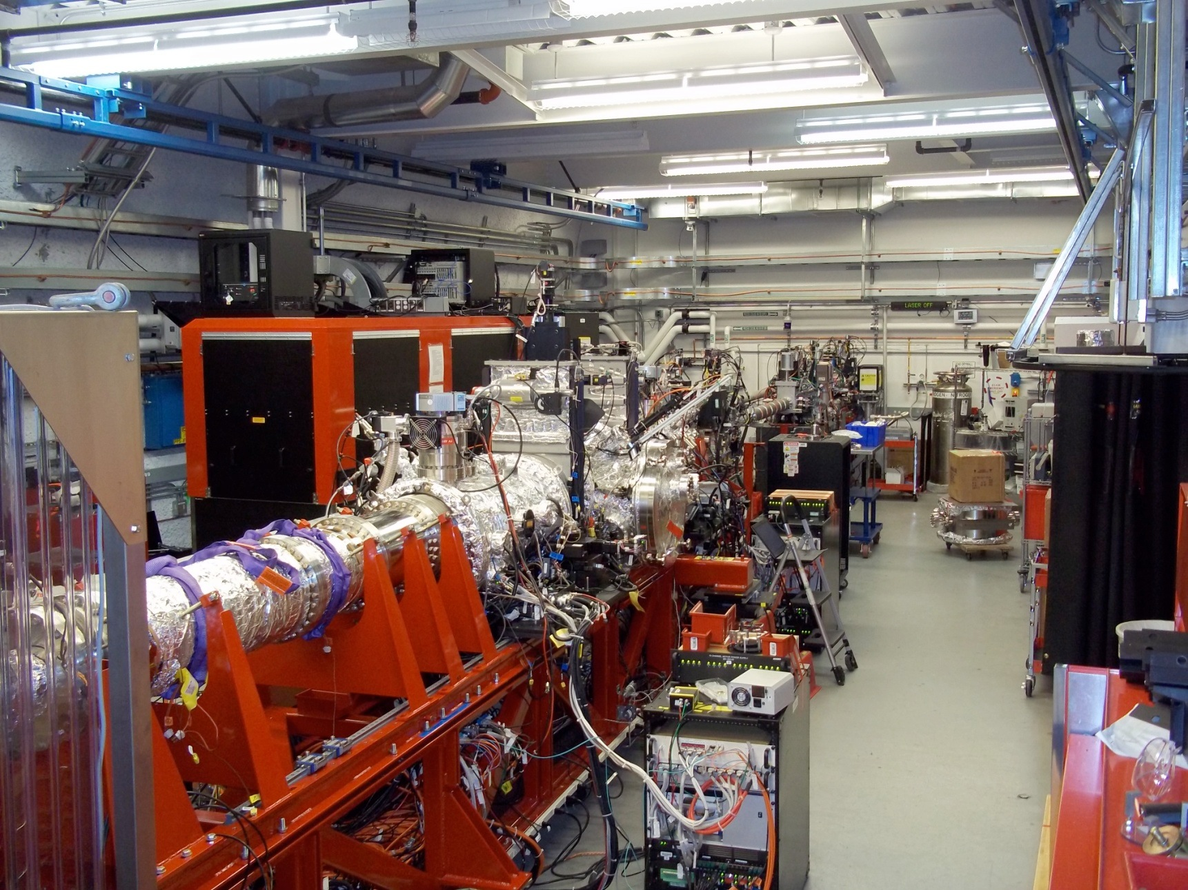
Coherent X-ray Imaging Instrument

Slide 12
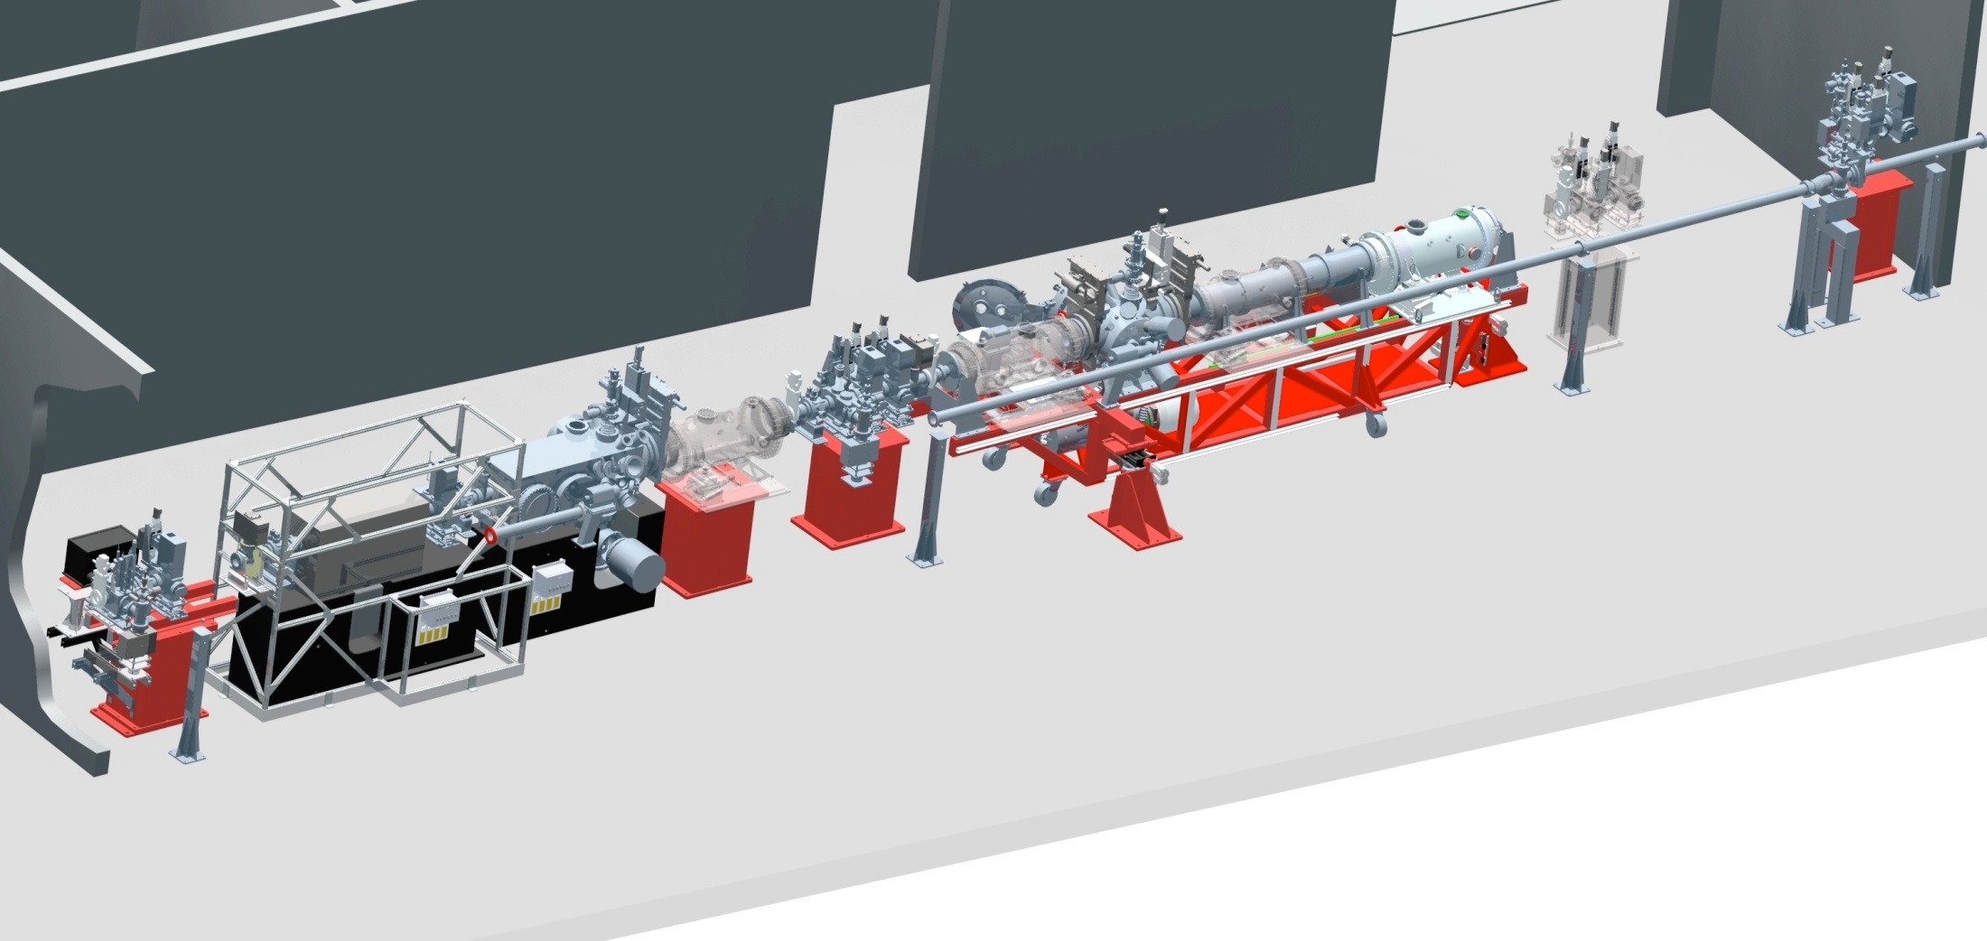
CXI Layout
Refocusing Lenses
Diagnostics/Slits
Diagnostics &
Wavefront Monitor
1 micron Sample Environment
0.1 micron KB & Sample Environment
Particle Injector and Ion TOF
1 micron KB
(inside thermal enclosure)
Boutet & Williams, New Journal of Physics 12, 035024 (2010)

Slide 13
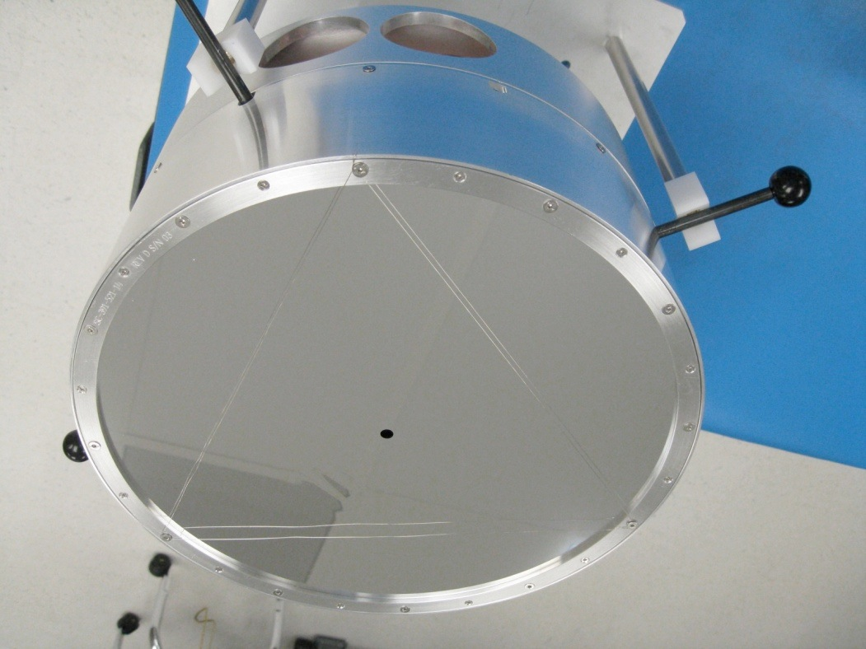
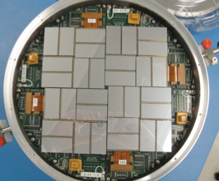

Cornell-SLAC Pixel Array Detector (CSPAD)
Cornell-SLAC Pixel Array Detector
2D Pixel Array Detector
  High resistivity Silicon (500 µm) for direct x-ray conversion.
  Reverse biased for full depletion.
  Bump-bonding connection to CMOS ASIC.
<1 photon readout noise
110x110 µm² pixels
1516 x1516 pixels
>10³ dynamic range
120 Hz readout
Tiled detector, permits variable ‘hole’ size
Collaboration with the Gruner Group at Cornell University

Slide 14
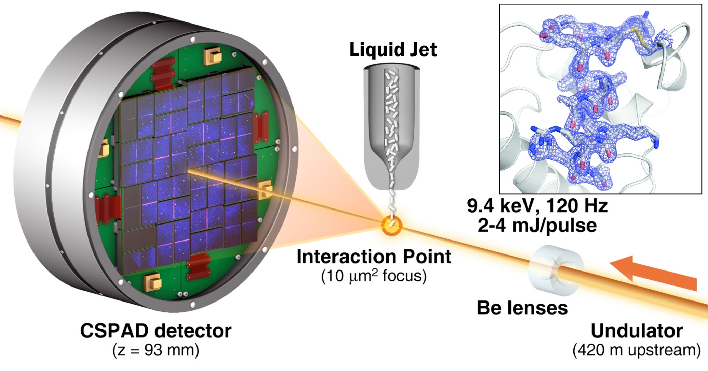
High Resolution Structure of Lysozyme Obtained Using Serial Crystallography
Dose is greatly reduced with 9 keV compared to 2 keV
~30 MGy or less with 3 micron focus and 1 x 1 x 3 micron crystals
Boutet et al., High-resolution protein structure determination by serial femtosecond crystallography. Science , 337(6092):362–364, 2012.

Slide 15
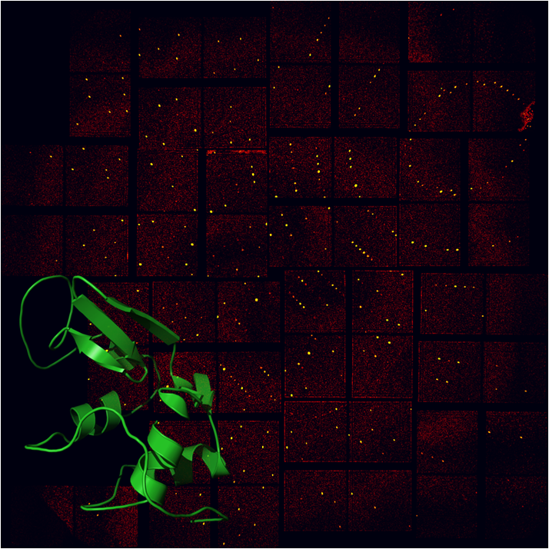
Lysozyme Bragg peaks are observed to the edge of the detector
Lysozyme single-shot diffraction at 9.3 keV, 40 fs pulses
Peaks observed to corner of the detector
  < 2 Å resolution
Resolution limited by photon energy and experimental geometry
1.86 Å resolution in the corner
Boutet et al., High-resolution protein structure determination by serial femtosecond crystallography. Science , 337(6092):362–364, 2012.

Slide 16

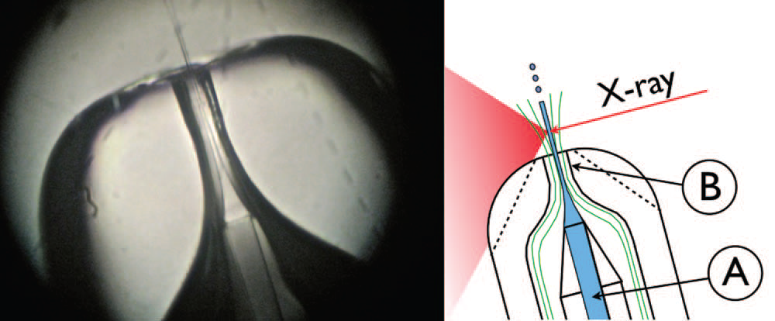
Liquid Jet Development at ASU
Many years of development by ASU at the ALS to optimize the system
Liquid jet for LCLS uses gas focusing
  Prevents clogging
  Submicron droplets from a bigger nozzle
Jet velocity
  ~10 m/s
Jet diameter
  ~4 micron
U. Weierstall, J. C. H. Spence, and R. B. Doak
Rev. Sci. Instrum. 83, 035108 (2012)

Slide 17
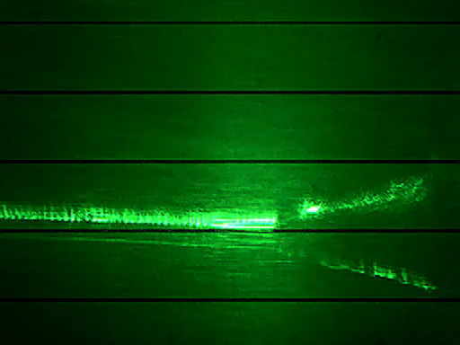
LCP stream hit by XFEL beam
X-ray pulses
1.6 mm/sec (190 nL/min)
LCLS at 120Hz
50 μm jet
100μm
green laser illumination synchronized with the LCLS X-ray pulses at 120 Hz

Slide 18
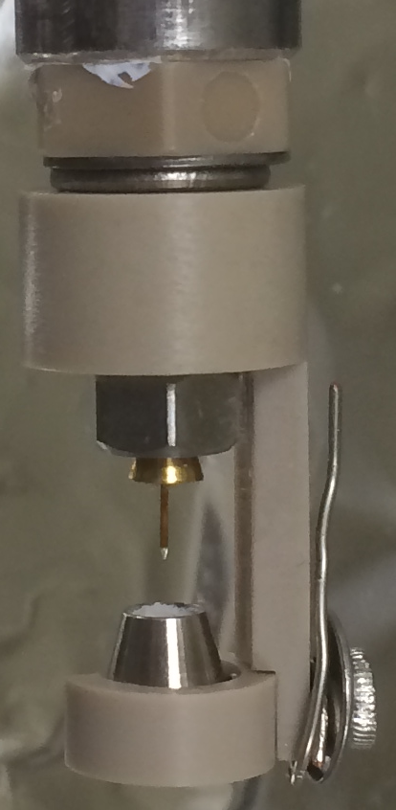
Electrokinetic Injection for PCS at CXI:
MESH on a Stick
Low flowrates (100’s nl/min)
  Viscous media slows flow
  Crystal-friendly additives such as glycerol, sucrose, and PEGs
Filter- and union-less setup
  Continuous capillary from reservoir to tip (ID: 50 – 100 µm), 1.5 m long
Carrier fluid should contain ions (~100 mM) and a viscous additive (e.g. 30% glycerol)
  Common to most cryo-protectant mother liquors
Applied voltages ~3 kV
Contact Ray Sierra from PULSE
6 mm

Slide 19
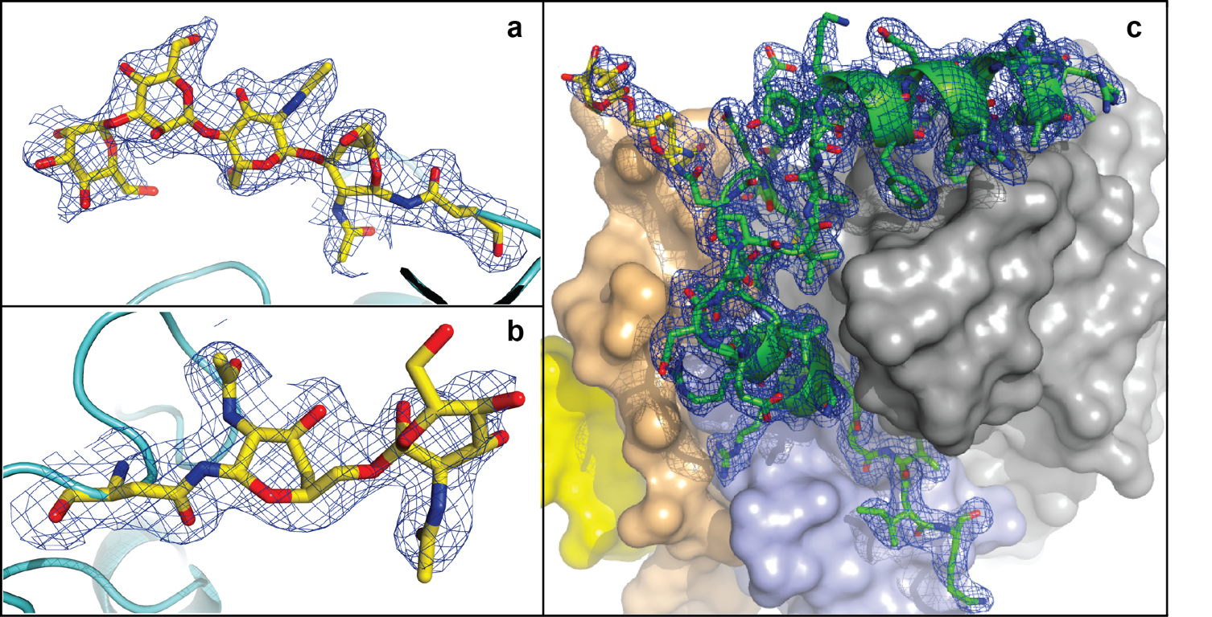
Structure determination of TbCatB by molecular replacement reveals a complex with a pro-peptide at 1.9 Å
New glycan moiety
New glycan moiety bound to pro-peptide
Pro-peptide bound to the active site
In-vivo grown crystal of a glyco-protein not previously known to high resolution
Koopmann etal, In vivo protein crystallization opens new routes in structural biology. Nature Methods , 9(3):259–U54, 2012

Slide 20
PCS program
http://www-ssrl.slac.stanford.edu/lcls/users/proposals.html
http://www6.slac.stanford.edu/news/2013-07-17-CRYSTAL-SCREENING-LCLS.aspx
fully supported GVDN system
only little sample needed
full data sets possible
about 4 month from deadline to running
6h beam time blocks

Slide 21
Recent Publications
X-Ray Diffraction from Isolated and Strongly Aligned Gas-Phase Molecules with a Free-Electron Laser. Phys. Rev. Lett. 112, 083002 – (Feb 2014)
De novo protein crystal structure determination from X-ray free-electron laser data. Nature 505, 244–247 (Jan 2014)
Lipidic cubic phase injector facilitates membrane protein serial femtosecond crystallography. Nature Communications 5, Article number: 3309 (Feb 2014)
Accurate macromolecular structures using minimal measurements from X-ray free-electron lasers. Nature Methods (Mar 2014)
Femtosecond X-ray diffraction from two-dimensional protein crystals, IUCrJ (2014). 1, 95-100
... still much more to come

Slide 22
Future perspectives
Improvements
  quick standard experiments (PCS)
  bigger and better detectors
  beam sharing
  more flexible sample handling
  easy to use analysis
New sources
  more instruments available
  higher repetition rate

Slide 23
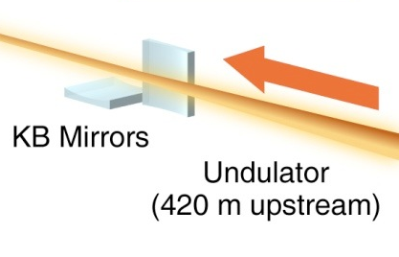
Creating More Beamtime at LCLS
Serial Serial Femtosecond Crystallography
The beam passing through a 4 micron water jet is minimally attenuated
> 97% transmission for 4 keV and above
Refocus and reuse the beam

Slide 24
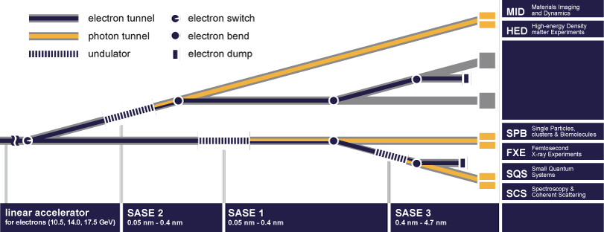
European XFEL

Slide 25
European XFEL
5MHz repetition rate
  about 10x300 pulses/s for SFX station
  fast triggers necessary
  faster sample delivery
large energy range 3-25 keV
dedicated SFX experiment
  uses refocussed beam from SPB beamline
  much more beam time for crystallography

Slide 26
Acknowledgements
BioXFEL
DOE/LCLS
DESY
CFEL
ASU
MPI Heidelberg
Cornell

Slide 27

End of presentation

